Slide 1
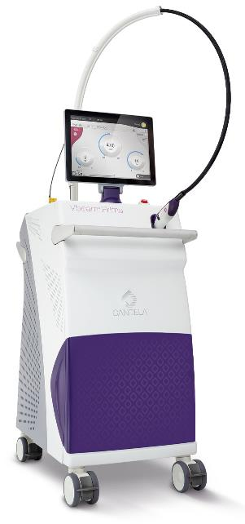
Vbeam® Family
Pulsed Dye Lasers
Vascular & Cutaneous Lesion Treatment
Summary of Select
Peer-reviewed Articles
PB98372EN
Updated March 2019

Slide 2
Selected Vbeam Articles for Various Clinical Applications
  Treatment of PWS in infancy without the need for general anesthesia
  Vbeam Prima with 15mm spot size improves rosacea and poikiloderma of Civatte significantly with a very favorable safety profile
  Adjunctive treatment for facial papulopustular eruptions from EGFR inhibitors
  Treatment of various vascular anomalies in a Chinese population
  Angiographic OCT imaging guidance for IH and PWB treatment
  Treatment of PWS in dark skin pediatric patients
  Comparison study with Cynergy and Vbeam showing significantly better results with Vbeam for PWS treatment
  Treatment of benign cutaneous lesion of capillaries (“Mibelli angiokeratoma”, “Telangiectatic warts”)
  Treatment of cutaneous facial lesions of hereditary hemorrhagic telangiectasia
  Treatment of PWS in Indian skin

Slide 3
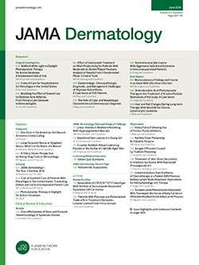

Pulsed dye laser treatment of port-wine stains in infancy without the need for general anesthesia
Jeon H, Bernstein LJ, Belkin DA, Ghalili S, Geronemus RG. JAMA Dermatol. 2019 Mar 13.
STUDY DETAILS
Retrospective review of 197 infants (73 boys, 124 girls), mean age of first treatment 3.38 months (range, 5-355 days) with Fitzpatrick skin types I –VI, treated for port-wine stains.
Vbeam Perfecta (595-nm PDL) parameters (determined by PWS location): spot size 10 to 12 mm, fluence 6.5 to 9.0 J/cm² and pulse duration of 0.45 to 1.5 ms.
Mean number of treatments was 9.8 (range 2-23, mean interval of 37.29 days). Topical or general anesthesia was not administered.
Independent grading by 4 physicians of clinical photography (before and 1 year after the initial treatment), using a 5-point scale: poor (0%-25%), fair (26%-50%), good (51%-75%), excellent (76%-99%), and complete (100%) clearance.
RESULTS
67% of all patients showed >75 to 100% improvement.
Mean grade for all patients was 3.65±1.26, corresponding to excellent clearance.
None of the patients experienced scarring or permanent pigmentary change.
All of the patients with darker skin types (IV - VI) did well, without any significant complications.
https://jamanetwork.com/journals/jamadermatology/fullarticle/2728098

Slide 4
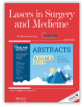
Pulsed-dye laser as an adjuvant treatment for papulopustular eruptions from epidermal growth factor receptor inhibitors, a randomized blinded split-faced controlled trial
Rerknimitr P, Suphankong Y, Panchaprateep R, et al. Lasers Surg Med. 2019 Mar 7.
STUDY DETAILS
14 subjects (8 males, 6 females; mean age 50±10.8 years) with facial acneiform eruptions due to EGFRis were enrolled. Subjects continued with EGFRi therapy during the study.
A randomized side of the face was treated with 595nm-PDL (Vbeam Perfecta), while the contralateral side served as a control.
Subjects received 4 treatments (at 2-week intervals): 10-mm spot size, 6-ms pulse width and fluence of 7 J/cm² for Fitzpatrick skin type IV and 7.5 J/cm² for skin type III.
Treatment was assessed by erythema index (EI) measured by colorimeter, papulopustular lesion count and physician global assessment (PGA).
RESULTS
In the laser-treated side, the mean EI decreased from a mean 23.5 at baseline to 16.3 at week 10.
Statistically significant improvement was observed in the PDL arm after 4 weeks and onward.
Mean lesion count decreased significantly from 58.07 at baseline to 15.9 at week 10.
Higher patient satisfaction in the PDL arm.
Side effects limited to mild erythema. No post-inflammatory hyperpigmentation observed.
https://www.ncbi.nlm.nih.gov/pubmed/?term=Pulsed-Dye+Laser+as+an+Adjuvant+Treatment+for+Papulopustular+Eruptions+From

Slide 5
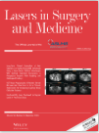

Treatment of poikiloderma of Civatte using a redesigned pulsed dye laser with a 15 mm diameter treatment spot
Bernstein EF, Schomacker K, Paranjape A, Jones CJ. Lasers Surg Med. 2018 Nov 27.
STUDY DETAILS
17 subjects (10 females, 7 males; mean age 55±4 years, range 47-61 years; Fitzpatrick Skin Types I-IV) with Poikiloderma of Civatte (POC) completed the study.
Vbeam Prima parameters for 4 monthly treatments:
  15mm with mean fluence 5-5.7 J/cm² , pulse repetition rate of 1.5 Hz.,1.5 ms pulse duration
  DCD cooling (40ms cooling/20ms delay).
3 blinded physician reviewers graded improvement on a 11-point scale of from 0 to 100% improvement in 10% increments.
RESULTS AT 2 MONTHS AFTER FINAL TREATMENT
Blinded evaluation success rate of 94% (16/17 post-treatment images correctly identified).
Significant improvement (P<0.0001) with mean score of 4.9, corresponding to 49.2% improvement.
No or mild transient erythema, purpura or edema following treatment.
No hypo-/hyperpigmentation or scarring.
https://onlinelibrary.wiley.com/doi/full/10.1002/lsm.23036

Slide 6
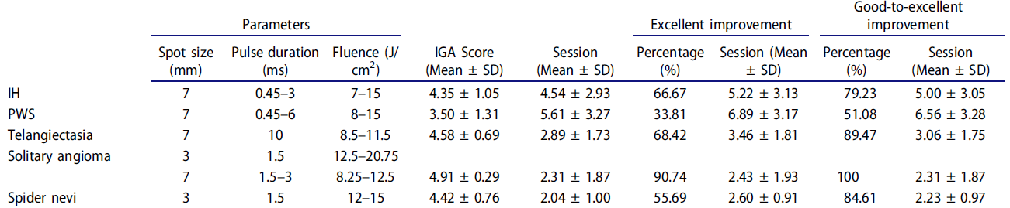
The application of 595-nm pulsed dye laser for vascular anomalies in a Chinese population: a 10-year experience
Lin MY, Lin CS, Hu S, et al. J Cosmet Laser Ther. 2018 Jul 27.
STUDY DETAILS
431 Chinese patients (259 females and 172 males; Fitzpatrick skin types III–IV) with 8 different types of vascular anomalies were treated with 595-nm PDL (Vbeam Perfecta) – see Table below.
Independent evaluation by 2 dermatologists, using an Investigator Global Assessment (IGA) 5-point scale of score 1=0%, no improvement to score 5=75–100%, excellent improvement.
RESULTS
Improvements were significantly correlated with infantile hemangioma (IH) subtypes.
Significant correlation between efficacy and lesion color, anatomical sites, and hypertrophic-type port-wine stain (PWS) was found (p < 0.05). No significant correlation between efficacy and age or sex (p > 0.05).
Pigmentary changes occurred with IH and PWS lesions only.
https://www.ncbi.nlm.nih.gov/pubmed/30052093

Slide 7

Angiographic optical coherence tomography imaging of hemangiomas and port wine birthmarks
Waibel JS, Holmes J, Rudnick A, et al. Lasers Surg Med. 2018 Mar 22.
STUDY DETAILS
49 subjects (21 hemangioma subjects and 28 PWB subjects), ranging from 3 months – 73 years old, and Fitzpatrick skin types I-V were enrolled.
Blood vessel depth and diameter was evaluated with optical coherence tomography (OCT).
Treatments with 595nm-PDL (Vbeam Perfecta): 7-10 millimeter spot size; fluence 7.0 – 9.5 J/cm², pulse duration 1.5 – 10 msec, and 30/20 – 20/10 cooling).
RESULTS
OCT images revealed that the blood vessel patterns in vascular lesions appeared dramatically different from that seen in normal skin.
Highly heterogeneous blood vessel patterns with vessel diameters ranging from 20 to 160 μm.
Largest vessels in the range 120 to 160 μm diameter were mainly at 0.50 millimeter depth.
PWB tended to have larger vessel diameters than hemangiomas but not necessarily higher density.
Vascular OCT may be used to give information to individualize laser settings.
https://www.ncbi.nlm.nih.gov/pubmed/29566276

Slide 8
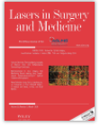
Pulsed Dye Laser Treatment of Rosacea using a Novel 15mm Spot Size
Bernstein EF, et al. Lasers Surg Med. Lasers Surg Med. 2018 Apr 10.
STUDY DETAILS
19 subjects (16 females, 3 males; mean age 52 years, range 36-69 years; Fitzpatrick Skin Types II-IV) with rosacea (primarily moderate to severe) were treated with 595nm pulsed dye laser.
Vbeam Prima parameters:
  Linear vessels: 3x10 mm spot size with fluence 15 J/cm² and 40ms pulses;
  Full face diffuse redness: 15mm with fluence range 6.25-7 J/cm² and 3ms pulse duration
  DCD cooling (40ms cooling/20ms delay).
3 (n= 2 subjects) or 4 treatments (n=17 subjects) administered at 4-week intervals.
3 blinded investigators graded rosacea on a 11-point scale of from 0 to 100% improvement in 10% increments.
RESULTS AT 2 MONTHS AFTER FINAL TREATMENT
Blinded evaluation success rate of 96.5% (55/57 post-treatment images correctly identified).
84.2% (16/19 subjects) had >40% improvement.
No hypo-/hyperpigmentation or scarring.
https://onlinelibrary.wiley.com/doi/full/10.1002/lsm.22819

Slide 9
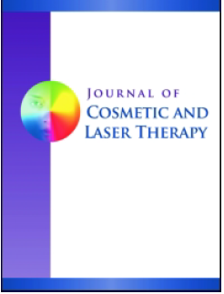
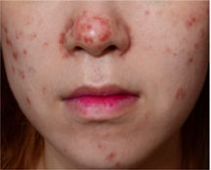
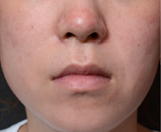
Treatment of post-pulsed dye laser purpura with pulsed dye laser
Chang YC, Lee SJ, Chung HJ. J Cosmet Laser Ther. 2018 Feb;20:21-23.
CASE STUDY DETAILS
3 Asian subjects with 585 nm PDL-induced purpura after treatment of acne erythema.
Treated with 595 nm Vbeam at 3 days (Figure below - case 1), 2 days (case 2) or same day (case 3) following PDL-induced purpura.
All patients had clinically-significant improvement following 1 or 2 Vbeam treatments with 595nm.
Treatment with 595nm PDL, which targets hemoglobin and its breakdown products, after initial PDL treatment may reduce post-PDL purpura & speed the resolution of purpura.
Figure 1a. Before single session of 595nm PDL (Vbeam Perfecta) using a setting of 10mm
spot size, 6 ms pulse duration, 7.5 J/cm² fluence. 1b. Four days after the treatment.
https://www.ncbi.nlm.nih.gov/pubmed/?term=post-pulsed+dye+laser+purpura

Slide 10

Successful treatment of two pediatric port wine stains in darker skin types using 595 nm laser
Bae YS, Ng E, Geronemus RG. Lasers Surg Med. 2016 Apr;48(4):339-42.
CASE REPORT 1
1-month old Fitzpatrick skin type V patient (African descent) with a PWS on the upper lip.
Vbeam treatment: 10% overlapping pulses,10mm spot size, 7.5 J/cm², pulse duration 1.5 ms, and dynamic cooling spray of 30 ms.
Cold hydrogel dressings were applied immediately after each treatment.
Complete resolution after 3 monthly treatments and no complications.
CASE REPORT 2
4 year old Fitzpatrick skin type V patient (African descent) with a PWS on the right side of the forehead and glabella.
Vbeam treatment: 10% overlapping pulses,10mm spot size, 7–8.25 J/cm², pulse duration 1.5 ms, and dynamic cooling spray of 30 ms.
Cold hydrogel dressings were applied immediately after each treatment.
Complete resolution after 2 treatments and no complications.
https://www.ncbi.nlm.nih.gov/pubmed/26749116

Slide 11

Prospective comparison treatment of 595-nm pulsed-dye lasers for virgin port-wine stain
Yu W, Ma G, Qiu Y, Chen H, et al. Br J Dermatol. 2015 Mar.
STUDY DETAILS
22 subjects with PWS treated on adjacent sites by both Vbeam and Cynergy 595nm PDL devices.
Vbeam parameters: radiant exposure of 11 J/cm², 1.5 ms pulse duration, 7 mm spot size, DCD cooling (30 ms cooling/20 ms delay).
Cynergy® (Cynosure Corp) parameters: radiant exposure of 11 J/cm², 2 ms pulse duration, 7 mm spot size, cold-air cooling system of level three.
3 treatments on both sites.
Chromameter and visual assessment at 2-months post treatment.
RESULTS
Average blanching rate was statistically higher for Vbeam sites (36.4%) compared to Cynergy sites (21.24%).
No scarring or permanent pigmentation change.
https://www.ncbi.nlm.nih.gov/pubmed/25130205

Slide 12
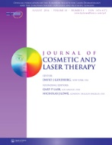
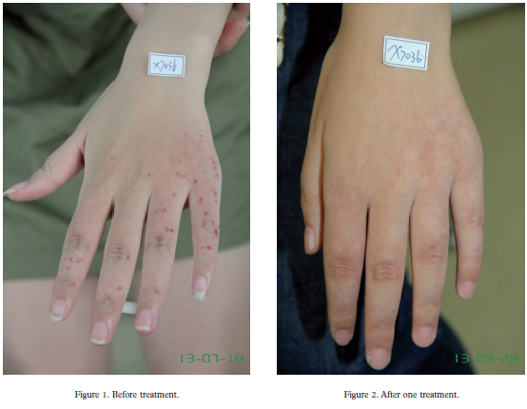
Efficacy of 595nm pulsed dye laser therapy for Mibelli angiokeratoma
Su Q, Lin T, Wu Q, Wu Y, Guo L, Ge Y. J Cosmet Laser Ther. 2015 Feb.
STUDY DETAILS
50 patients with Mibelli angiokeratoma (cutaneous lesion of capillaries).
Vbeam parameters: pulse duration of 10ms, spot size of 7 mm, energy fluency 12-13.5 J/cm² with 10% overlapping pulses and DCD cooling.
Up to 4 treatments repeated at intervals of 4-6 weeks until the lesion was cleared, or the patients discontinued the treatment.
Investigator and subject assessment at ~3 months after treatment, using a 4-point scale: no change or mild improvement, 0 – 30%; moderate improvement, 30 – 60%; significant improvement, 60 – 95% and fully recovered, 95 – 100%.
RESULTS AT 3 MONTHS AFTER FINAL TREATMENT
92% of lesions had at least moderate improvement to full clearance.
80% showed significant or full clearance.
Most common skin effect was purpura and edema, which usually lasted for 12h to several days.
Temporary pigment changes were not commonly seen after treatment. No scarring or skin atrophy was observed.
https://www.ncbi.nlm.nih.gov/pubmed/25549813

Slide 13
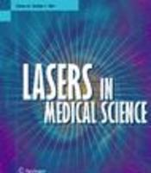
Treatment of the skin manifestations of hereditary hemorrhagic telangiectasia with pulsed dye laser
Halachmi S, Israeli H, Ben-Amitai D, Lapidoth M. Lasers Med Sci. 2014 Jan.
STUDY DETAILS
8 patients (5 males, 3 females, Fitzpatrick Skin Type II-IV) with cutaneous facial lesions of hereditary hemorrhagic telangiectasia (HHT).
Vbeam parameters: pulse duration of 10ms, spot sizes of 5-7 mm, energy fluency 9.5-11 J/cm², 1.5msec pulses and DCD cooling (30msec spray/20msec delay).
All lesions received 2 stacked pulses during treatment.
Treatments repeated at 3-month intervals until satisfactory clinical improvement achieved.
2 independent physicians graded photographs, using a 5-point scale.
RESULTS
All patients exhibited excellent (75-100%) clearance after a mean of 2.6 treatments (range 1-8).
In comparison, a control group of patients with non-HHT facial telangiectasia required a mean of 1.9 (range 1-5; p< 0.05) treatments.
No adverse events were reported in either group.
https://www.ncbi.nlm.nih.gov/pubmed/23681198

Slide 14
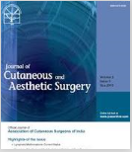
Treatment of port-wine stains with flash lamp pumped pulsed dye laser on Indian skin: a six year study
Thajudheen CP, Jyothy K, Priyadarshini A. J Cutan Aesthet Surg. 2014 Jan.
STUDY DETAILS
75 patients (44 females, 31 males, age range 8 months to 43 years, Fitzpatrick Skin Type IV&V) with PWS underwent multiple (6-17) treatments at monthly intervals.
Vbeam parameters: spot sizes 7-10mm, energy fluency 6-12 J/cm², 0.45-10ms pulses, single pass with 10% overlapping, and DCD cooling.
2 independent dermatologists graded photographs, using a quartile grading scale.
Subjects followed up at 6 monthly intervals to observe re-darkening of PWS.
RESULTS
All patients who had at least 6 treatments showed improvement.
70% of pediatric subjects and 50% of adults had a grade 3 response (61-80% clearance) after 8-10 treatments.
No re-darkening of PWS during the study.
Lesions over the face cleared better than other areas.
PWS in children <5 years of age responded faster than adults due to thinner lesions that were bright pink in color.
Erythema, edema and crusting lasted 5-7 days. No major side effects.
Post inflammatory hyperpigmentation (n=19 cases, 30%) resolved by 1-2 months.
https://www.ncbi.nlm.nih.gov/pubmed/24761097

Slide 15
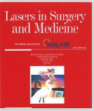
Rosacea treatment using the new-generation, high-energy, 595 nm, long pulse-duration pulsed-dye laser
Bernstein EF, Kligman A. Lasers Surg Med. 2008 Apr.
STUDY DETAILS
20 subjects (18 females, 2 males with Fitzpatrick Skin Types I-III) with rosacea were treated.
Vbeam parameters for linear vessels: elliptical spot size 3x10mm, energy fluency 17-19 J/cm², 40ms pulses, and DCD cooling (40ms cooling/20ms delay).
Entire face was then treated with Vbeam parameters: 12mm spot size, 6-7 J/cm², 3ms pulses, and DCD cooling (40ms cooling/20ms delay).
4 treatments administered at 4-week intervals.
Investigators graded rosacea on a 0 (no rosacea) - 6 (severe rosacea) scale.
Blinded assessment of photos, using a 5-point scale of 0=no improvement to 4=76-100% improvement.
RESULTS AT 8 WEEKS AFTER FINAL TREATMENT
Rosacea scores decreased significantly after 4th treatment and at follow-up (p<0.001).
79% of paired images showed overall improvement by blinded assessment.
No hypo-/hyperpigmentation or scarring.
https://www.ncbi.nlm.nih.gov/pubmed/18412227

